Slide 1
Searching and Mining Trillions of Time Series Subsequences under Dynamic Time Warping
by Thanawin Rakthanmanon, Bilson Campana, Abdullah Mueen, Gustavo Batista, Brandon Westover, Qiang Zhu, Jesin Zakaria, Eamonn Keogh
KDD’12, August 12–16, 2012, Beijing, China.
王建新 2015年1月8日

Slide 2

块似？形似？神似？
1
2
3
4

Slide 3
诱人的东北方向
x1
x2
x3
x4
x5
x6
x7
x8
y8
y7
y6
y5
y4
y3
y2
y1

Slide 4
增量计算
2 | 9 | 1 | 7 | 0 | 8 | 3 | 6 | 1 | 5 | 2 | 4 | 7 | 7 | 3
C | A | A | C | B
A | B | A | C | B | C | C | A | A | C | B | A | A | C | b

Slide 5
积沙成塔，集腋成裘

Slide 6
世袭制 v.s. 竞争制
1
9
4
5
8
4
6
7
7
8
8
0
2
2
7
5
9
6
8
8
3
3
6
4
3
6
5
7

Slide 7
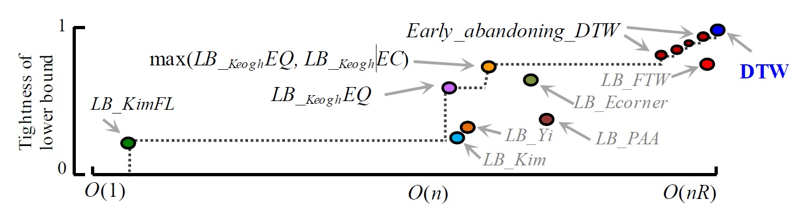
海选 + 正赛

Slide 8
钓鱼式执法

Slide 9
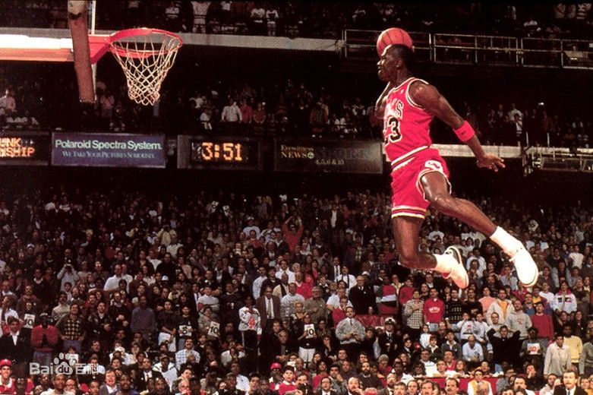
霸气外露，自信爆棚

Slide 10
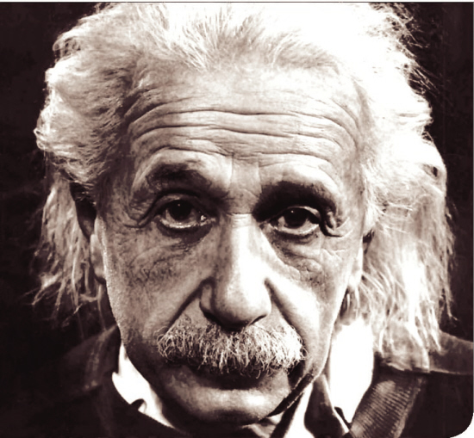
弦断谁听？

Slide 11
Thanks!

